Slide 1
Bit Manipulation
~Shri_874

Slide 2
Question Set
https://shorturl.at/fyNjh

Slide 3
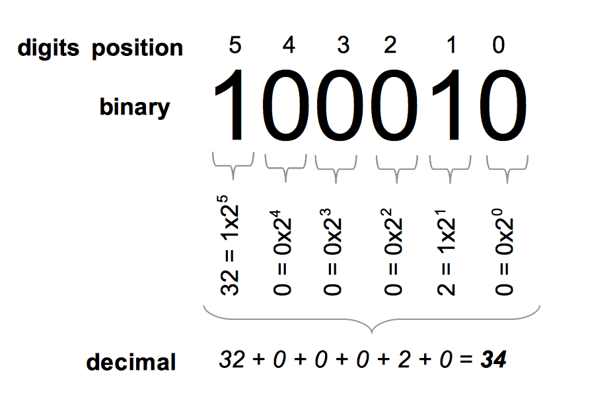
Binary - Decimal

Slide 4
The 6 Bitwise Operators
AND (&)
OR (|)
XOR (^)
NOT (~)
Left Shift (<<)
Right Shift (>>)

Slide 5
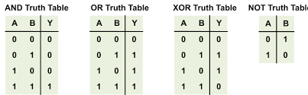
Truth Tables

Slide 6
Bitwise Shifts
Left Shift (<<): Shifts bits left, filling with 0s.
Example: 5 << 1 = 10 (0101 << 1 = 1010)
Right Shift (>>): Shifts bits right.
Example: 5 >> 1 = 2 (0101 >> 1 = 0010)

Slide 7
Bit Manipulation
Consider the ith bit in a number.
Setting this Bit: num | (1 << i)
Clearing this Bit: num & ~(1 << i)
Checking if this bit is set: (num & (1 << i)) > 0
Toggling this Bit: num ^ (1 << i)

Slide 8
Questions
https://codeforces.com/contest/2020/problem/C
https://codeforces.com/contest/1872/problem/E
https://codeforces.com/contest/1903/problem/D1

Slide 9
Topic 4: Bit Searching & Subsets
Each subset of an n-element set can be represented as an n-bit number.
Set {1,2,3} → Subsets:
000 → {}
001 → {3}
010 → {2}
011 → {2,3}
100 → {1}
101 → {1,3}
110 → {1,2}
111 → {1,2,3}

Slide 10
Questions
https://atcoder.jp/contests/abc197/tasks/abc197_c
Tip : N <= 20? Happy!

Slide 11
Topic 5: DP Using Bits
Dp[i] -> ans when subset I has been considered
Dp[i][j] -> ans with subset I and j being the last element that was chosen.
Converts O(n!) to O(2^n)

Slide 12
Questions
https://atcoder.jp/contests/abc142/tasks/abc142_e
https://atcoder.jp/contests/abc199/tasks/abc199_e

Slide 13

Thank you

